Slide 1
Basic - r

Slide 2
Introducing R
R is more than just a program that does statistics. It is a sophisticated computer language and environment for statistical computing and graphics
R is a powerful statistical program but it is first and foremost a programming
language. Many routines have been written for R by people all over the world
and made freely available from the R project website as “packages.”

Slide 3
Getting the hang of R
R is unlike most current computer programs in that you must type commands into the console window to carry out most tasks you require. Throughout the text, the use of these commands is illustrated, which is indeed the point of the book.
Where a command is illustrated in its basic form, you will see a fixed width font to mimic the R display
like so:
help.start()

Slide 4
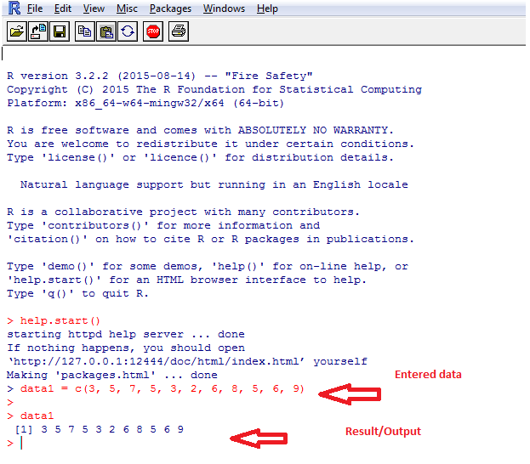
Example

Slide 5
Downloading and Installing R from CRAN
The Comprehensive R Archive Network (CRAN) is a network of websites that host the R program and that mirror the original R website. The benefit of having this network of websites is improved download speeds.
For all intents and purposes, CRAN is the R website and holds downloads
(including old versions of software) and documentation (e.g. manuals, FAQs). When you perform searches for R-related topics on the internet, adding CRAN (or R) to your search terms increasesyour results. To get started downloading R,

Slide 6
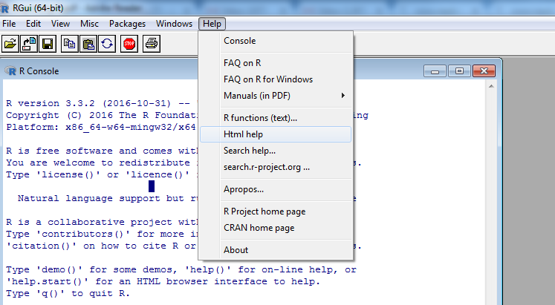
R-Help

Slide 7

Command Packages
The R program is built from a series of modules, called packages. These packages are libraries of commands that undertake various functions. When you first start R several packages are loaded on your computer and become ready for use. You can see what is available by using the search() command like so:

Slide 8
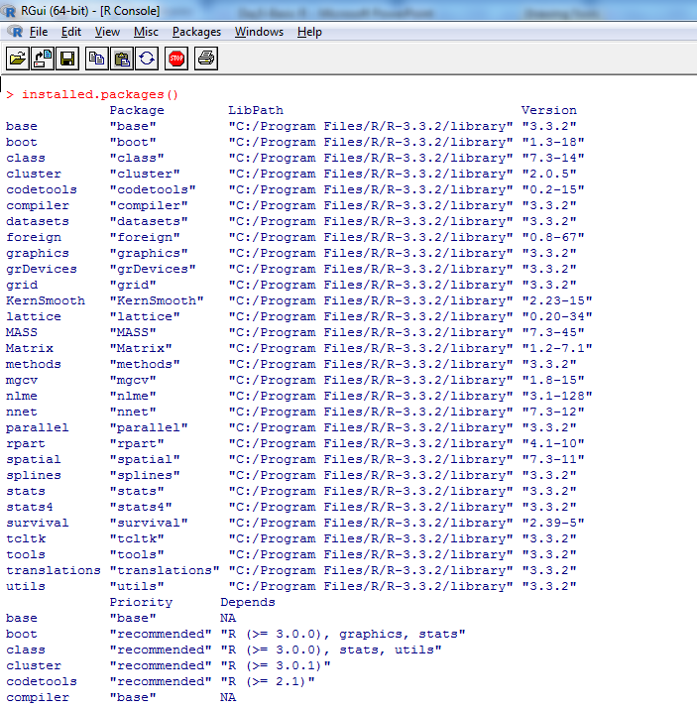
Standard Command Packages
When you use the search() command you can see what packages are loaded and ready for use. You can see, for example, the graphics package, which carries out many of the routines required to create graphs.
Several other packages are ready-installed but not automatically loaded and immediately available.
For example, the splines package contains routines for smoothing curves, but is not automatically loaded. To see what packages are available you can type: installed.packages()

Slide 9
Loading & Removing or Unloading Packages
It is simple to load packages as required. Start by issuing the following command:
library(package)
If you have loaded some packages and want to remove one, perhaps to free up an overwritten
command, you can use the detach() command like so:
detach(package:name)

Slide 10
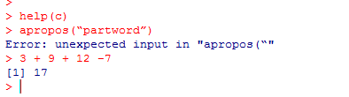
use R like a calculator
You can think of R as a big calculator; it will perform many complicated calculations but generally,
these are made up of smaller elements. To see how you can use R in this way, start by typing in some
simple math:
> 3 + 9 + 12 -7
[1] 17

Slide 11
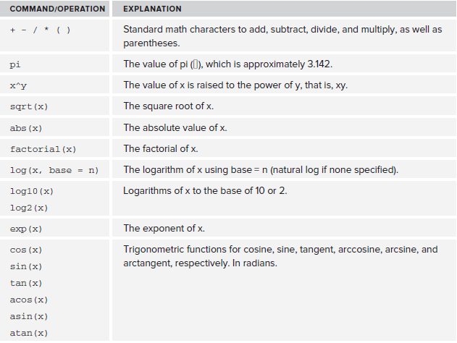
Some of the Mathematical Operations Available in R

Slide 12
Type Some Math
1. Now try using the abs() command with some math:
abs(12-17*2/3-9)
2. Now type a simple factorial:
factorial(4)
3. Next, try typing the following logarithms (all give the same answer because they are different forms
log10(2)
4. Now type in a natural log:
> log(2)
5. Follow up by typing the exponent:
> exp(0.6931472)
6. Type in a logarithm again:
> log10(2)
7. Reverse the logarithm like so:
> 10^0.30103

Slide 13

Entering Numerical Items as Data
Numerical data do not need any special treatment; you simply type the values, separated by commas, into the c() command.
In the following example, imagine that you have collected some data (a sample) and now want to get the values into R:
>data1 = c(3, 5, 7, 5, 3, 2, 6, 8, 5, 6, 9)
Now just create a new object to hold your data and then type the values into the parentheses. The
values are separated using commas.
The “result” is not automatically displayed; to see the data you must type its name:
> data1
[1] 3 5 7 5 3 2 6 8 5 6 9

Slide 14
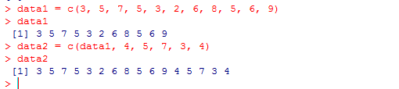
You can incorporate existing data objects with values to make new ones simply by incorporating them as if they were values themselves (which of course they are). In this example you take the numerical sample that you made earlier and incorporate it into a larger sample:
> data1
[1] 3 5 7 5 3 2 6 8 5 6 9
> data2 = c(data1, 4, 5, 7, 3, 4)
> data2
[1] 3 5 7 5 3 2 6 8 5 6 9 4 5 7 3 4

Slide 15

Entering Text Items as Data
If the data you require are not numerical, you simply use quotes to differentiate them from numbers. There is no difference between using single and double quotes; R converts them all to double. You can use either or both as long as the surrounding quotes for any single item match, as shown in the
following:
our.text = c(“item1”, “item2”, ‘item3’)
The following example shows a simple text sample comprising of days of the week:
> day1 = c('Mon', 'Tue', 'Wed', 'Thu')
> day1
[1] "Mon" "Tue" "Wed" "Thu"

Slide 16
You can combine other text objects in the same way as you did for the numeric objects previously,
like so:
> day1 = c(day1, 'Fri')
> day1
[1] "Mon" "Tue" "Wed" "Thu" "Fri“
If you mix text and numbers, the entire data object becomes a text variable and the numbers are converted to text, shown in the following. You can see that the items are text because R encloses each item in quotes:
> mix = c(data1, day1)
> mix
[1] "3" "5" "7" "5" "3" "2" "6" "8" "5" "6" "9" "Mon"
[13] "Tue" "Wed" "Thu" "Fri"

Slide 17
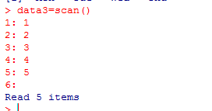

Using the scan Command for Making Data
When using the c() command, typing all those commas to separate the values can be a bit tedious. You can use another command, scan(), to do a similar job. Unlike the c() command you do not insert the values in the parentheses but use empty parentheses. The command then prompts you to enter your data. You generally begin by assigning a name to hold the resulting data like so:
our.data = scan()
data3 = scan()

Slide 18
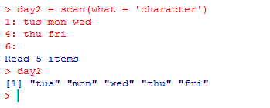
Entering Text as Data
You can enter text using the scan() command, but if you simply enter your items in quotes you will get an error message. You need to modify the command slightly like so:
scan(what = 'character')
> day2 = scan(what = 'character')
1: Mon Tue Wed
4: Thu
5:
Read 4 items

Slide 19
Using the Clipboard to Make Data
The scan() command is easier to use than the c() command because it does not require commas. The command can also be used in conjunction with the clipboard, which is quite useful for entering data from other programs (for example, a spreadsheet). To use these commands, perform the following steps:
1. If the data are numbers in a spreadsheet, simply type the command in R as usual before switching to the spreadsheet containing the data.
2. Highlight the necessary cells in the spreadsheet and copy them to the clipboard.
3. Return to R and paste the data from the clipboard into R. As usual, R waits until a blank line is entered before ending the data entry so you can continue to copy and paste more data as required.
4. Once you are finished, enter a blank line to complete data entry.
To tell R you are using this separator, simply add an extra part to your command like so:
scan(sep = ‘,’)
In this example R is told to expect a comma; note that you need to enclose the separator in quotes. Here are some comma-separated numerical data:
23,17,12.5,11,17,12,14.5,9
11,9,12.5,14.5,17,8,21

Slide 20
To get these into R, use the scan() command like so:
> data4 = scan(sep = ',')
1: 23,17,12.5,11,17,12,14.5,9
9: 11,9,12.5,14.5,17,8,21
16:
Read 15 items
> data4
[1] 23.0 17.0 12.5 11.0 17.0 12.0 14.5 9.0 11.0 9.0 12.5 14.5 17.0 8.0 21.0
The set of operations appears as follows:
> data5 = scan(sep = ',', what = 'char')
1: "Jan","Feb","Mar","Apr","May","Jun"
7: "Jul","Aug","Sep","Oct","Nov","Dec"
13:
Read 12 items
> data5
[1] "Jan" "Feb" "Mar" "Apr" "May" "Jun" "Jul" "Aug" "Sep" "Oct" "Nov" "Dec"

Slide 21
Reading a File of Data from a Disk
To read a file with the scan() command you simply add file = ‘filename’ to the command. For example:
> data6 = scan(file = 'test data.txt')
Read 15 items
> data6
[1] 23.0 17.0 12.5 11.0 17.0 12.0 14.5 9.0 11.0 9.0 12.5 14.5 17.0 8.0 21.0
In this example the data file is called test data.txt, which is plain text, and the numerical values are separated by spaces.
R looks for your data file in the default directory. You can find the default directory by using the
getwd() command like so:
> getwd()
[1] "C:/Documents and Settings/Administrator/My Documents"

Slide 22
It may be easier to point permanently at a directory so that the files can be loaded simply by typingtheir names. You can alter the working directory using the setwd() command:
setwd('pathname')
When using this command, replace the pathname part with the location of your target directory. The location is always relative to the current working directory, so to set to my Desktop I used the following:
> setwd('Desktop')
> getwd()
[1] "/Users/markgardener/Desktop“
You can look at a directory and see which files/folders are within it using the dir() or list.
files() command:
dir()
list.files()

Slide 23
Reading Bigger data Files
The scan() command is helpful to read a simple vector. More often though, you will have complicated data files that contain multiple items (in other words two-dimensional items containing both rows and columns). Although it is possible to enter large amounts of data directly into R, it is more likely that you will have your data stored in a spreadsheet. When you are sent data items, the spreadsheet is also the most likely format you will receive. R provides the means to read data that is stored in a range of text formats, all of which the spreadsheet is able to create.

Slide 24
The read.csv() Command
In most cases you will have prepared data in a spreadsheet. Your dataset could be quite large and it would be tedious to use the clipboard. When you have more complex data it is better to use a new command—read.csv():
read.csv()
As you might expect, this looks for a CSV file and reads the enclosed data into R. You can add a variety of additional instructions to the command. For example:
read.csv(file, sep = ',', header = TRUE, row.names)
You can replace the file with any filename as before. By default the separator is set to a comma but you can alter this if you need to. This command expects the data to be in columns, and for each column to have a helpful name. The instruction header = TRUE, the default, reads the first row of the CSV file and sets this as a name for each column. You can override this with header = FALSE. The row. names part allows you to specify row names for the data; generally this will be a column in the dataset (the first one is most usual and sensible). You can set the row names to be one of the
columns by setting row.names = n, where n is the column number.

Slide 25
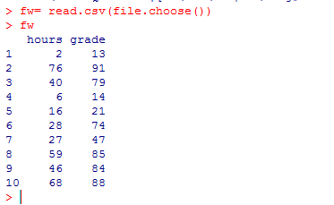
1. Now assign the file a sensible name and use the read.csv() command as follows:
> fw = read.csv(file.choose())

Slide 26
Alternative Commands for Reading Data in R
There are many other formats besides CSV in which data can exist and in which other characters, including spaces and tabs, can separate data. Consequently, the read.table() command is actually the basic R command for reading data. It enables you to read most formats of plain-text data. However, R provides variants of the command with certain defaults to make it easier when specifying some common data formats, like read.csv() for CSV files. Since most data is CSV though, the read.csv()is the most useful of these variants. But you may run into alternative formats, and the following list outlines the basic read.table() as well as other commands you can use to read various types of data:

Slide 27
In the following example the data are separated by simple spaces. The read.table() command is a more generalized command and you could use this at any time to read your data. In this case you have to specify the additional instructions explicitly. The defaults are set to
header = FALSE, sep = “ “ (a single space), and dec = “.”, for example.
data1 data2 data3
1 2 4
4 5 3
3 4 5
3 6 6
4 5 9
> my.ssv = read.table(file.choose(), header = TRUE)
> my.ssv = read.csv(file.choose(), sep = ' ')

Slide 28
The next example shows data separated by tabs. If you have tab-separated values you can use the read.delim() command. In this command R assumes that you still have column heading names but this time the separator instruction is set to sep = “\t” (a tab character) by default:
data1 data2 data3
1 2 4
4 5 3
3 4 5
3 6 6
4 5 9
> my.tsv = read.delim(file.choose())
> my.tsv = read.csv(file.choose(), sep = '\t')
> my.tsv = read.table(file.choose(), header = TRUE, sep = '\t')

Slide 29
These commands essentially all perform the same function; the differences lie in the defaults. Regardless of which method you choose, getting data into R is a fundamental operation; you cannot do anything without having the data first. Bear the following checklist in mind when looking to get data from disk:
1 Check the format of the data file and note the separator character.
2 Look to see if columns are labeled.
3 Use the appropriate read.xxx() command to get your data into R. The read.csv() command is the most useful and has the fewest additional instructions to type.
4 You can use the file.choose() instruction to save typing the filename in full unless you are using a Linux computer.
5 Make sure the name you select for your data is short but meaningful; this cuts down on typing and helps you to find it later.
6 If your data has row names use the row.names = instruction to point to the column in the file that contains them.

Slide 30
Missing Values in Data Files
In the examples you have seen so far the samples in the data files have all been the same length. In the real world samples are often of unequal size. The following example contains two samples, one called mow and one called unmow. The mow sample contains five values, whereas the unmow sample contains only four values. When these data are read into R from a spreadsheet or text file, the program recognizes that you have multiple columns of data and sets them out accordingly. R makes your data into a neat rectangular item and fills in any gaps with NA.
In the following example the data were stored in a CSV file and were read into R with the read.csv()
command:
> grass = read.csv(file.choose())
> grass
mow unmow
1 12 8
2 15 9
3 17 7
4 11 9
5 15 NA

Slide 31
Here the data have been called grass and you can see that R has filled in the gap using NA. R always pads out the shorter samples using NA to produce a rectangular object. This is called a data frame. The data frame is an important kind of R object because it is used so often in statistical data manipulation and is how you generally have data in spreadsheets.
R recognizes NA as a special kind of data object. It is important to know when your data contains NA items and what to do when you encounter them.

Slide 32
Viewing Named Objects
So far you have seen examples of creating data objects from some simple math and from reading in data files. In a general way you “make” new items by providing a name followed by the instruction that creates it. R is object oriented, which means that it expects to find named things to deal with in some way. For example, if you are conducting an experiment and collecting data from severalsamples, you want to create several named data objects in R in order to work on them and do your
analyses later on.
As a reminder, the following examples show a few of the different ways you have seen thus far to create named items:
answer1 = 23 + 17/2 + pi/4
my.data = read.csv(file.choose())
sample1 = c(2, 5, 7, 3, 9, 4, 5)
Now it is time to learn how to view these items in R and remove them as necessary.

Slide 33
Viewing Previously Loaded Named-Objects
Once you have made a few objects and have them stored in R, you might forget what you have previously loaded as time goes on. You need a way to see what R objects are available; to do this you use the ls() command like so:
ls()
The ls() command lists all the named items that you have available. You can also use the objects() command; (this is identical in function but slightly longer to type!) The result of either command is to
list the objects stored in R at the current moment:
> ls()
[1] "answer1" "my.data" "sample1"

Slide 34
Viewing Only Matching Names
You may want to limit the display to objects with certain names; this is especially helpful if you have a lot of data already in R. You can limit the display by giving R a search pattern to match. For
example:
> ls(pattern = 'b')
[1] "bare" "beetle.cca" "beta" "bf" "bf.beta"
[6] "bf.lm" "biol" "biol.cca" "biomass" "bird“
[11] "bp" "bs" "bss" "but" "but.lm"
[16] "cbh" "cbh.glm" "cbh.sf" "food.b" "nectar.b"
[21] "pred.prob" "prob2odd" "tab.est" "tab1" "tab2“
Here the pattern looks for everything containing a “b”. This is pretty broad so you can refine it by adding more characters:
> ls(pattern = 'be')
[1] "beetle.cca" "beta" "bf.beta"

Slide 35
Now the pattern picks up objects with “be” in the name. If you want to search for objects beginning with a certain letter you use the ^ character like so:
> ls(pattern = '^b')
[1] "bare" "beetle.cca" "beta" "bf" "bf.beta"
[6] "bf.lm" "biol" "biol.cca" "biomass" "bird"
[11] "bp" "bs" "bss" "but" "but.lm"
Compare the following search listings. In the first case the pattern matches objects beginning with “be” but in the second case the letters are enclosed in square brackets:
> ls(pattern = '^be')
[1] "beetle.cca" "beta"
> ls(pattern = '^[be]')
[1] "bare" "beetle.cca" "beta" "bf" "bf.beta"
[6] "bf.lm" "biol" "biol.cca" "biomass" "bird"
[11] "bp" "bs" "bss" "but" "but.lm"
[16] "eF" "eF2" "env"

Slide 36
The effect of the square brackets is to isolate the letters; each is treated as a separate item, hence objects beginning with “b” or “e” are matched. You can receive the same result using a slightly different
approach as well:
ls(pattern = '^b|^e')
The vertical brace (sometimes called a pipe) character stands for or, that is, you want to search for objects beginning with “b” or beginning with “e”.
To find objects ending with a specific character you use a dollar sign at the end like so:
> ls(pattern = 'm$')
[1] "bf.lm" "but.lm" "cbh.glm" "dep.pm"
[5] "dm" "frit.glm" "frit.lm" "frit.sum"
[9] "hlm" "mf.lm" "mr.lm" "n.glm"
[13] "newt.glm" "newt.test.glm" "sales.lm" "sm"
[17] "t.glm" "test.glm" "test.lm" "test1.glm"
[21] "tt.glm" "worm.pm"

Slide 37
You can use the period as a wildcard and R will match any character:
> ls(pattern = 'a.e')
[1] "area" "bare" "date" "sales" "sales.frame"
[6] "sales.lm" "sales.ts" "water"
> ls(pattern = 'a..e')
[1] "tab.est" "treatment"

Slide 38
Removing objects from R
You can remove objects from memory and therefore permanently delete them using the rm() or remove() commands. To remove objects you can simply list them in the parentheses of the command:
rm(list)
remove(list)
You can type the names of the objects separated by commas. For example:
>rm(answer1, my.data, sample1)
This removes the objects answer1, my.data, and sample1 from the workspace.
You can use the ls() command to produce a list, which will then be deleted. You need to include the instruction list in the command like so:
>rm(list = ls(pattern = '^b'))
Here the ls() command is used to search for objects beginning with “b” and remove them.

Slide 39
Types of Data Items
So far you have seen how to create some simple mathematical results, how to create simple samples, and how to read in more complex data containing multiple columns. Now is a good time to look at the types of data items that you may come across. Your data items can exist in one of two forms: numbers or text values. R regards these as numeric or character.

Slide 40
Number Data
Plain values that are whole numbers are integer values, whereas values that contain decimals are numeric. The distinction is fairly minor, but if you have a list of values that contain both integers and decimals, R will regard the entire sample as numeric.
> data3
[1] 6 7 8 7 6 3 8 9 10 7 6 9
> data7
[1] 23.0 17.0 12.5 11.0 17.0 12.0 14.5 9.0 11.0 9.0 12.5 14.5 17.0 8.0 21.0
In the first example the values are all whole numbers. In the second example some of them have decimal places, but R appends decimals to all of the data to achieve an equal level of precision; in this case they all have at least one decimal place.

Slide 41
Text Items
If you do not have numbers, you must have text. R recognizes two sorts of text data items. You can think of the first kind as plain text labels; R calls these character values.
> data8
[1] "Jan" "Feb" "Mar" "Apr" "May" "Jun" "Jul" "Aug" "Sep" "Oct" "Nov" "Dec"

Slide 42
converting Between number and text data
You can shift between the two kinds of text quite easily. The following example begins with data that is a factor. The as.character() command is used to convert to plain text. Then the plain text is converted back to a factor using the as.factor() command:
> cut
[1] mow mow mow mow mow unmow unmow unmow unmow
Levels: mow unmow
> cut2 = as.character(cut)
> cut2
[1] "mow" "mow" "mow" "mow" "mow" "unmow" "unmow" "unmow" "unmow"
> cut3 = as.factor(cut2)
> cut3
[1] mow mow mow mow mow unmow unmow unmow unmow
Levels: mow unmow

Slide 43
In this case new data objects were created but the original object could be overwritten with the new one. You can do a similar thing with numbers. If you begin with data that contain decimals, that is, numeric, you can convert to integers using the as.integer() command. You can convert integer values to numeric using the as.numeric() command:
> data7
[1] 23.0 17.0 12.5 11.0 17.0 12.0 14.5 9.0 11.0 9.0 12.5 14.5 17.0 8.0 21.0
> data7i = as.integer(data7)
> data7i
[1] 23 17 12 11 17 12 14 9 11 9 12 14 17 8 21
> data7n = as.numeric(data7i)
> data7n
[1] 23 17 12 11 17 12 14 9 11 9 12 14 17 8 21
You can also convert numbers to text using as.character():
> data7c = as.character(data7)
> data7c
[1] "23" "17" "12.5" "11" "17" "12" "14.5" "9" "11" "9" "12.5"
[12] "14.5" "17" "8" "21"

Slide 44
This works out fine if the text is sensible; in the preceding example the text values were originally numbers. Now see what happens if you try this on a factor:
> cut
[1] mow mow mow mow mow unmow unmow unmow unmow
> cut.n = as.numeric(cut)
> cut.n
[1] 1 1 1 1 1 2 2 2 2

Slide 45
Data Frames
A data frame is a two-dimensional object, that is, it has rows and columns. R treats the columns as separate samples or variables, and the rows represent the replicates or observations. All data frames are rectangular and R will pad out any “short” columns
using NA.
There are two columns; one represents a sample called mow and contains five replicates/observations. The second column is called unmow and contains
four observations:
> grass
mow unmow
1 12 8
2 15 9
3 17 7
4 11 9
5 15 NA

Slide 46
> grass
species cut
1 12 mow
2 15 mow
3 17 mow
4 11 mow
5 15 mow
6 8 unmow
7 9 unmow
8 7 unmow
9 unmow
The second form of the data frame is most useful, especially for statistical analyses. This is because there are no NA items.

Slide 47
List Objects
A list is a series of items bundled together to form a single object. In the following example the grass data you met previously has been made into a list:
> grass.l
$mow
[1] 12 15 17 11 15
$unmow
[1] 8 9 7 9
When you look at it you see each vector listed separately along with its name, which is prefixed with a dollar sign. This example list is very simple and contains only two vectors. A list could be constructed from objects of various sorts, and you might have, for example, a matrix, a data frame, and several vectors containing a mixture of numbers and characters.

Slide 48
Examining Data Structure
As you collect and work on new data you will inevitably build a collection of items. Different kinds of analysis will require different approaches, and you will need to examine a data object in order to work out what kind it is so that you can determine the best strategy for dealing with it.
The vector is the smallest unit in the data structure. When you start to bundle vectors together you make more complex items. The complex item you make can be a data frame, a matrix, or a list.
a simple vector will be a one-dimensional set of characters or numbers. A data frame or a
matrix will have a rectangular two-dimensional structure.
You can use the str() command to examine the structure of an object
like so:
> str(grass)
'data.frame': 9 obs. of 2 variables:
$ species: int 12 15 17 11 15 8 9 7 9
$ cut : Factor w/ 2 levels "mow","unmow": 1 1 1 1 1 2 2 2 2

Slide 49
Writing Vector Objects to Disk
If you have a vector, you can use the write() command. The basic form of the command is the following:
write(x, file = "data", ncolumns = if(is.character(x)) 1 else 5, sep = " ")
This looks a bit complicated because the ncolumns = part contains a conditional statement. This is because the if() statement creates a file with multiple columns according to the type of data. If the data are text, a single column is created. If the data are numeric, five columns are created (you can alter the number of columns). The items are separated by a space by default; you can change this by altering the sep = instruction. For example, the following code snippet contains a list of numbers.
The write() command sees that these are numeric and creates five columns by default. The data are separated with commas.
> data7
[1] 23.0 17.0 12.5 11.0 17.0 12.0 14.5 9.0 11.0 9.0 12.5 14.5 17.0 8.0 21.0
write(data7, file = 'Desktop/data7.txt', sep = ',')
write.csv(mydata, file = 'filename', row.names = TRUE, sep = ',', col.names =
TRUE)

Slide 50
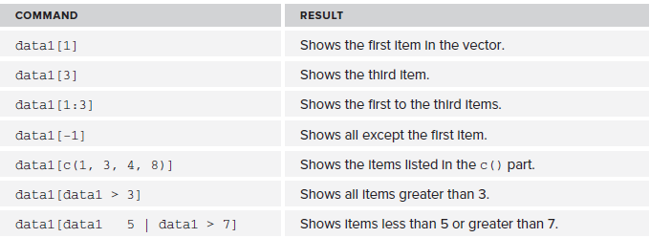
Selecting and Displaying Parts of a Vector
Being able to select and display parts of a vector can be important for many reasons. For example, if you have a large sample of data you may want to see which items are larger than a certain value.Alternatively you may want to extract a series of values as a subsample in an analysis. Being able to select parts of a vector is a basic skill that underpins many more complicated operations in R.
Here is a simple vector of numbers that form a sample:
> data1
[1] 3 5 7 5 3 2 6 8 5 6 9

Slide 51
length(data1)
This tells you how many elements there are in the vector, including NA items.
You can use other operations. In the following example the max() command is used to get the largest value in the vector:
> data1
[1] 3 5 7 5 3 2 6 8 5 6 9
> max(data1)
[1] 9
> which(data1 == max(data1))
[1] 11
The first command, max(), gives the actual value that is the largest numerical value in the vector (in this case 9). The second command asks which of the elements is the largest. The value obtained is 11, meaning that the eleventh item in the vector is the largest. Notice that double equal signs are used here.

Slide 52
seq(start, end, interval)
data1[seq(1, length(data1), 2)]
[1] 3 7 3 6 5 9
This would pick out a sequence beginning with the first and ending with the last and with an interval of two. In other words, you select the first, third, fifth, and so on.
> data5
[1] "Jan" "Feb" "Mar" "Apr" "May" "Jun" "Jul" "Aug" "Sep" "Oct" "Nov" "Dec"
> data5[-1:-6]
[1] "Jul" "Aug" "Sep" "Oct" "Nov" "Dec“
Here the last six months in your vector of months are picked out. In the following example the biggest value is selected:
> which(data5 == max(data5))
[1] 9
In this example R has selected the ninth item, which is “Sep”. The items are sorted alphabetically,
so the biggest is determined by that order as opposed to a numerical value.

Slide 53
Sorting and Rearranging a Vector
You can rearrange the items in a vector to be in one order or another using the sort() command. The default is to use ascending order and to leave out any NA items, like so:
> unmow
[1] 8 9 7 9 NA
> sort(unmow)
[1] 7 8 9 9
In the preceding example, you can see that the numbers have been re-ordered and the NA item has been stripped out. You can alter the sort order by using decreasing = TRUE as an additional instruction in the command:
> sort(unmow, decreasing = TRUE)
[1] 9 9 8 7

Slide 54
You can change the way NA items are dealt with using the na.last = instruction. You have three options: the default is NA, meaning they are dropped. If you use TRUE the NA items are placed last and if you use FALSE they are placed first:
> sort(unmow, na.last = NA)
[1] 7 8 9 9
> sort(unmow, na.last = TRUE)
[1] 7 8 9 9 NA
> sort(unmow, na.last = FALSE)
[1] NA 7 8 9 9

Slide 55
Returning Logical Values from a Vector
Previously you saw how the which() command was used to tell which items in a vector met some criterion. See the following code snippet for a reminder:
> data1
[1] 3 5 7 5 3 2 6 8 5 6 9
> which(data1 == 6)
[1] 7 10
Here it has been determined that the seventh and tenth items are equal to 6; note that two = signs are used like so ==.
If you omit the which() command and use the == directly you get a different sort of answer:
> data1 == 6
[1] FALSE FALSE FALSE FALSE FALSE FALSE TRUE FALSE FALSE TRUE FALSE
> data8
[1] "Jan" "Feb" "Mar" "Apr" "May" "Jun" "Jul" "Aug" "Sep" "Oct" "Nov" "Dec"
> data8 == 'Feb'| data8 == 'Apr'
[1] FALSE TRUE FALSE TRUE FALSE FALSE FALSE FALSE FALSE FALSE FALSE FALSE

Slide 56
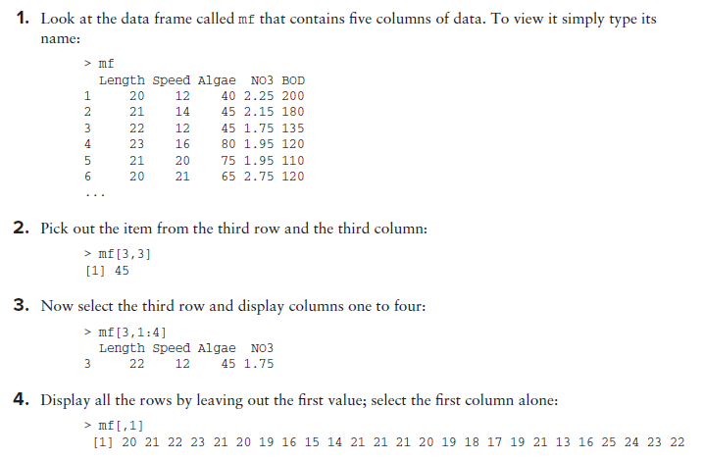
Selecting and Displaying Parts of a Matrix or Data Frame
Use the mf data from the Beginning.RData file for this activity, which you explore here by
selecting out various parts using the square bracket syntax.

Slide 57
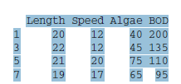
5. Specify several rows but leave out a value at the end to display all columns:
> mf[c(1,3,5,7),]
Length Speed Algae NO3 BOD
1 20 12 40 2.25 200
3 22 12 45 1.75 135
5 21 20 75 1.95 110
7 19 17 65 1.85 95
6. Now specify several rows but use a -4 to indicate that you want to display all columns except the fourth:
> mf[c(1,3,5,7),-4]

Slide 58
7. Because the columns are named you can select one by using its name rather than a simple value:
> mf[c(1,3,5,7), 'Algae']
[1] 40 45 75 65
8. Try giving a single value in the square brackets:
> mf[3]
Algae
1 40
2 45
3 45
4 80
5 75
6 65
7 65

Slide 59
Opening Complicated Data Objects
Using the $ to retrieve a column from a data frame is sometimes a tedious process. You can temporarily make the items within a data object available for R to “see” using the attach() command
This allows the columns of a data frame and the elements of a list to be viewed without the need to use the $ sign. For example:
attach(my.list)
attach(mf)
The items that are attached do not appear when you do an ls() command. You can see which items are attached using the search() command:
> search()
[1] ".GlobalEnv" "package:MASS" "mf"
[4] "tools:RGUI" "package:stats" "package:graphics"
[7] "package:grDevices" "package:utils" "package:datasets"
[10] "package:methods" "Autoloads" "package:base"

Slide 60
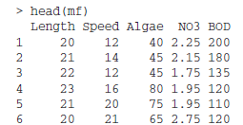
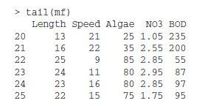

Quick Looks at Complicated Data Objects
head(mf)
tail(mf)
head(bird, n = 3)

Slide 61
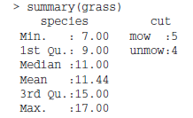

summary(grass)
names(my.list)

Slide 62
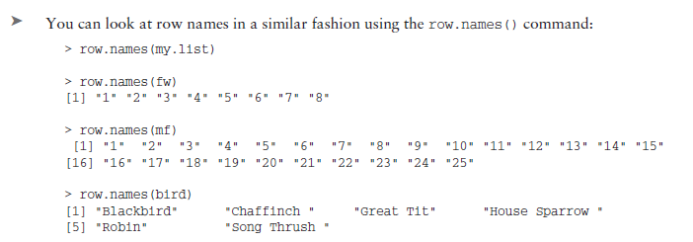
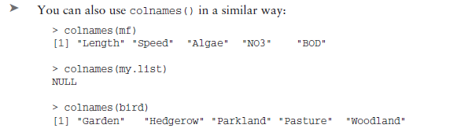

Slide 63
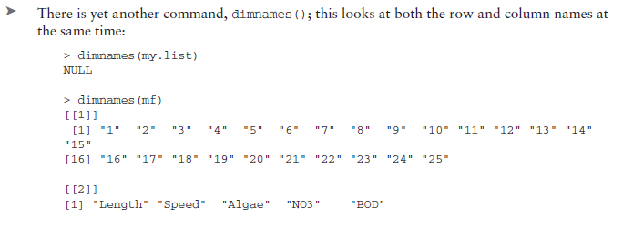

Slide 64
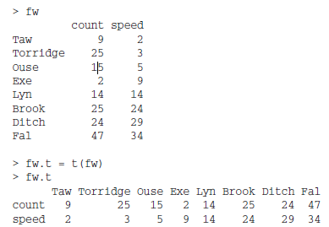
Rotating Data Tables – transpose command

Slide 65
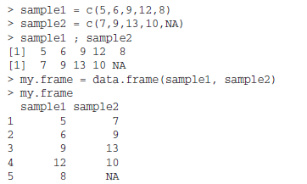
Making Data Frames
A data frame is a collection of columns of data. The various columns can be different sorts so you might have several columns of numbers and several of characters. The important thing is that all the columns are the same length; in other words, the vectors that go in to make up the frame are of the same length. Any “short” vectors are padded out using NA. To make a data frame you use the data.frame() command:
my.frame = data.frame(item1, item2, item3)

Slide 66
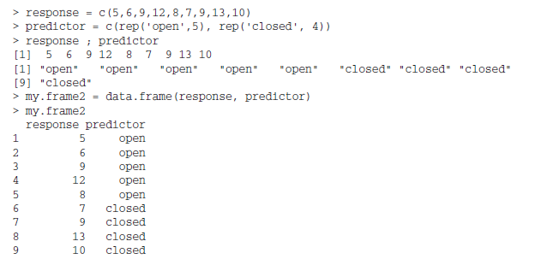
You can use a command called rep() to repeat items multiple times. The general form
of the command is: rep(item, times)

Slide 67
> length(unmow) = length(mow)
> mow;unmow
[1] 12 15 17 11 15
[1] 8 9 7 9 NA
If you set the length() of the vector to a value greater than its current length, NA items are added at the end. If you set the length() to a value smaller than its current length, values at the end are lost. If you want to create a data frame from vectors of different lengths, the shorter vectors will need to be lengthened using NA so that all the vectors are the same length. In the preceding example the length of the longest vector was used to set the length of the shorter ones like so:
length(short.vector) = length(long.vector)
This saves time, typing, and errors. You can easily check which the longest vector is; once you know this you can use the preceding command. You can also use the up arrow to recall the last command

Slide 68
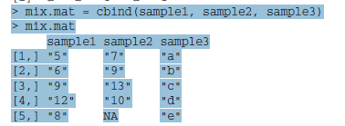
Making Matrix Objects
A matrix is also a rectangular object, and the columns of a matrix are also of equal length. You can create a matrix using one of several commands, depending what objects you have to begin with. If you have vectors of data that you want to form the columns of your matrix, you can combine them using the cbind() command. The following example uses the same two numeric vectors created earlier:
sample1 ;
[1] 5 6 9 12 8
sample2
[1] 7 9 13 10 NA
sample3
[1] "a" "b" "c" "d" "e“
> rmat = rbind(sample1, sample2)
> rmat
[,1] [,2] [,3] [,4] [,5]
sample1 5 6 9 12 8
sample2 7 9 13 10 NA

Slide 69
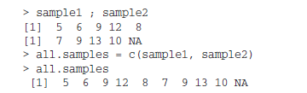
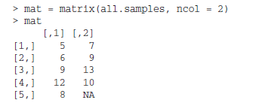


Slide 70
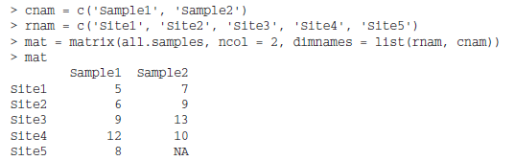
dimnames() command to make labels for both rows and columns at the same time

Slide 71
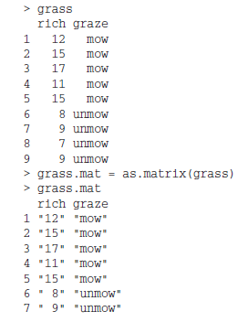
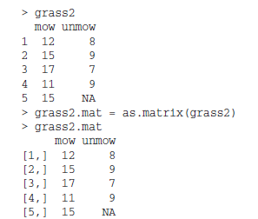
Convert a Data Frame into a Matrix
Converting objects between forms:
as.data.frame()
as.matrix()
as.list()

